Slide 1

UNIT
DAY 11
01
PLAN THEN BUILD
GAMES OF LOGIC
AGENDA
REMINDERS
Phones into The Holding Cell
Laptops, and your build materials
Criterion C rubric sheet
What Today Is
What You Hand In
How It Is Marked
What A Plan Needs
The Gate
The Work, In Order
Checklist
RECOMMENDED LISTENING:
WACKY WORKBENCH (US) – SONIC CD

Slide 2
WHAT TODAY IS
Today you write the plan for building your game, and then you build a rough version of it
Criterion C starts today and runs through to Day 14
What you build today is a PROTOTYPE
  It is meant to look rough
Don’t spend your time making it look pretty

Slide 3
TODAY’S WORK
Folder slide 22 - your production plan, with minutes on every step
Folder slide 23 - a photo of the paper prototype you build today
Folder slide 25 - the first row of your changes log
A one-page rules sheet, on paper, in your folder
The first three are Criterion C. The bands are on your Criterion C rubric sheet

Slide 4
HOW TODAY IS MARKED
Criterion C, strands i and iv today, and the start of ii and iii
Strand i is the plan on folder slide 22. Strand iv is the changes log on folder slide 25
  Strand iii is the word "follows", so a plan written after the build cannot be marked at all
The full scale is on your Criterion C rubric sheet

Slide 5
WHAT A PLAN NEEDS IN IT
The steps, in the order you will do them. Ten to fourteen is normal
Minutes expected for each step
  You won’t know exactly, and that is fine
What that step needs: card, scissors, the printer, twenty minutes
  One step has to be "write the rules sheet“
    It is on your requirements list
A table or a bullet list, either is fine
→ FOLDER SLIDE 22

Slide 6
MAKE AN HONEST PLAN
You are not only marked on the plan. You are marked on whether you then followed it
  So an ambitious plan is worse than an honest one
If you write that the art takes ten minutes and it takes forty, that reads worse than writing forty in the first place
Write the plan you are actually going to follow, not the one that sounds impressive
The criterion says "sufficient for peers to be able to follow”

Slide 7
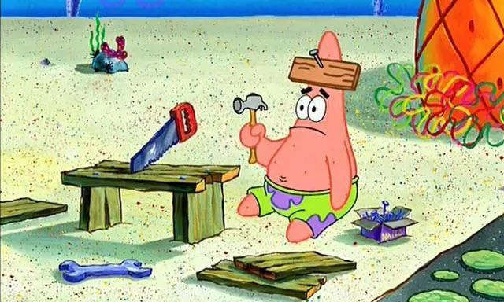
WHAT THE PROTOTYPE IS FOR
Use any tools at your disposal
It is supposed to look rough
  Next lesson we’ll test our games, and then analyze what changes we need to make
→ FOLDER SLIDE 23

Slide 8
LOGGING WHAT CHANGED
Your plan will go wrong. Everyone’s does, and that is not a problem
What matters is that you write down what changed and why, on folder slide 25, today
Changing it silently earns nothing at all
In the unlikely event that NOTHING changes, still note that down
→ FOLDER SLIDE 25

Slide 9
THE RULES SHEET
One page, one side, diagrams included
  On paper
Ensure that you complete this, because when writing the rules you may uncover mechanics that you were unfamiliar with
  Things you will find you have not decided: who goes first, what happens on a tie, and what happens when the deck runs out
It goes in your folder, not your bag
Goal: somebody can play the game based on your rules sheet without asking you (the designer) any questions

Slide 10
WHY THE RULES SHEET MATTERS
Next lesson somebody else plays your game off that sheet while you sit there saying nothing
We run a stopwatch against three minutes to teach and ten to play
It is not graded today, but it will provide you valuable data
No sheet next lesson means no playtest, and no playtest means no data

Slide 11
THE WORK, IN ORDER
0:21 to 0:33 - folder slide 22, write the plan. Laptops only
0:33 to 0:41 - the gate. Somebody reads your plan out loud
0:41 to 1:05 - build it, then photograph onto folder slide 23
1:05 to 1:15 - the rules sheet, on paper
1:15 to 1:20 - first changes log row on folder slide 25

Slide 12
IF YOU MISSED TODAY
All of it works on your own. Only the gate needs another person, and any person will do
1. Folder slide 22 - ten to fourteen steps, minutes and resources on each, one of them the rules sheet
2. Read the plan aloud to somebody and change whatever they trip over
3. Build the rough prototype, then photograph it onto folder slide 23
4. One-page rules sheet on paper, brought to the next lesson
5. First changes log row on folder slide 25, dated
Without a rules sheet you cannot be playtested next lesson, so that one is the priority

Slide 13
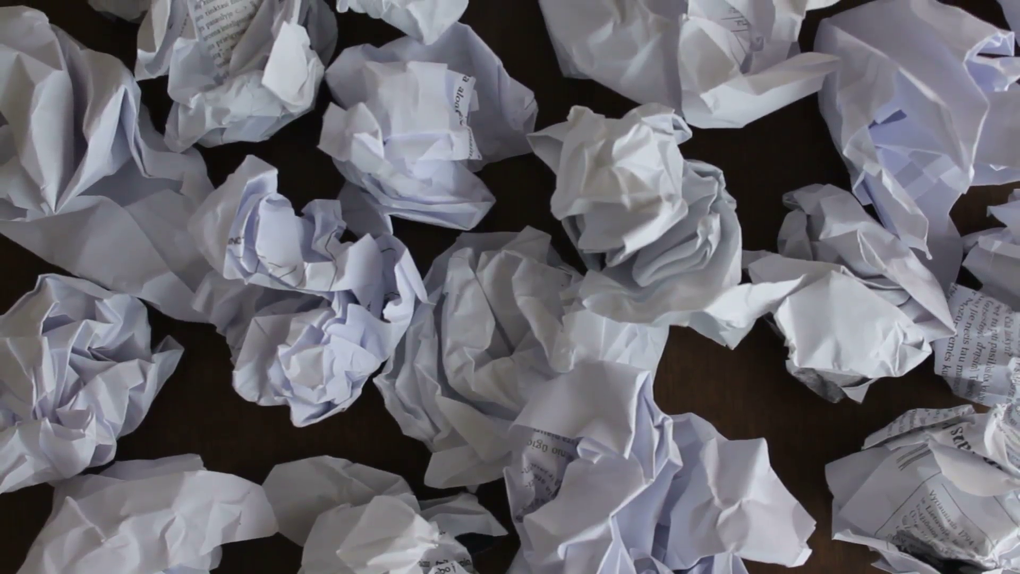
CHECKLIST BEFORE YOU LEAVE
Folder slide 22 - the plan, with times on it
Folder slide 23 - a photo of the rough thing you built
Folder slide 25 - one row in the changes log, even if the row says "nothing changed"
Rules sheet in your folder, not in your bag. It will get CRUMPLED
Next time:
Playtest 1. Somebody else plays your game while you sit there and say nothing at all!

